Slide 1
Industrial Engineering Data Management System for Garments industry
Project Members:
Noman, Md Abdullah Al ID: 14-28106-3 Program: SE
Das, Sudipta ID: 14-28145-3 Program: CSSE
Mustafa, H.M. faysal Ibne ID: 14-28079-3 Program: SE
Supervisor:
Md. Shamsur Rahim
Department of Computer Science
Faculty of Science & IT
American International University-Bangladesh

Slide 2
Declaration
We declare that the submitted project is our original work and has not been submitted in any form for another degree or diploma at any university or other institute of tertiary education. Information derived from the published and unpublished work of others has been acknowledged in the text and a list of references is given.
We declare that this project does not contain any content that discloses the secret of any organization or related parties. American International University – Bangladesh (AIUB) will not be held liable for any such activities, as for the project is presented as our original work.
Noman, Md Abdullah Al ID: 14-28106-3 Program: SE | Das, Sudipta ID: 14-28145-3 Program: CSSE | Mustafa, H.M. Faysal Ibne ID: 14-28145-3 Program: SE

Slide 3
Approval This software project “Industrial Engineering Data Management System for Garments industry” has been submitted to the following respected members of the board of examiners of the Department of Computer Science in partial fulfillment of the requirements for the degree of Bachelor of Science in Computer Science and Software Engineering
Md. Shamsur Rahim
Supervisor & Lecturer
Department of Computer Science Faculty of Science & IT
American International University-Bangladesh
Dr. Dip Nandi
Head of the department
Department of Computer Science Faculty of Science & IT
American International University-Bangladesh
Mashiour Rahman
Director
Department of Computer Science
Faculty of Science & IT
American International University-Bangladesh
Professor Dr. Tafazzal Hossain
Dean
Faculty of Science and information Technology
American International University-Bangladesh
Dr. Carmen Z. Lamagna
Vice Chancellor
American International University-Bangladesh

Slide 4
Project history
Field Study: We went to visit an industry named Sadia Fashion. Address Plot # 4, Road # 27/Ka, Rupnagar Rd, Dhaka, Bangladesh. They are Contract based small production industry
Problematic Field: Their order size small (5000-15000) and production line is max 2 to 3, they can handle their data manually by pen and paper, no computerized data collection. This causes a minor problem for report generating and further analysis after a month or year, on profit- loss. But if the industry is big, multiple line of work then it is near impossible to handle such massive amount of data. This why we need automated system that will work for any kind, any size of garments industry.
Background to the Problem: Due to lack of data, they cannot analyze their production. They cannot evaluate each worker accurately. As they do not keep data of employee, they cannot point out the fault in the production line. They cannot monitor hourly production rate. They cannot accurately predict production for each employee and their maximum capability of production

Slide 5
Related Field Study
We studied on existing software in market related garments for better understanding of our project and find out what betterment can be done . We studied on
Faabe
Marg
Startex
Drost

Slide 6
Study on SDLC models
We did study on SDLC and SDLC models like
Traditional Models:
1. Waterfall Model
2. Iterative Model
3. Spiral Model
4. V – Model
5. Prototyping Model
Agile Methods:
Scrum
Extreme Programming (XP
Feature Driven Development (FDD)
4. Dynamic Systems Development Method (DSDM)

Slide 7
Why we choose Scrum
Problem with Traditional Methods :
Our requirements are not clear and software is not safety critical. So waterfall model is not good for us. There will be also good amount of change in requirements.
Iterative method , Prototyping model is an option but our time limit is too short for iterative method or Prototyping model. it also does not support mass amount of change.
As we need to adapt change overtime, so V-model and spiral model will not work.
So we moved to AGILE . In Agile Methods
we can’t follow XP because our team is too short
FDD needs some experience for the development and also features can be changed over time
DSDM support urgent business need but there is no industry’s business need now.
That leads us to Scrum. In Scrum
supports small iteration or sprint, it support small group.
In the other SDLC method, we need a project manager but we don’t have any project manager. Scrum team is responsible for project management.
So SCRUM is best for us in this sector.

Slide 8
User Story
1.1 Log in (supervisor)
1.2 Log in (Manager )
1.3 Log in Owner)
2.0 entry Data
3.1 Report (Manager )
3.2 Report (Owner)

Slide 9
User Requirements
# primary
1. User can log in with Username and password.
2. User can enlist new employee or remove them.
3. User can entry production data into the software.
4. They can add or delete column, edit data afterwards.
5. User can generate report from the data for any duration of time
6. Data access will be controlled according to the role of user.
7. Manager will able to initiate new product into the product list and store order document.
# Secondary:
1. For a particular type of product, running states(completed percentage, number of workers, total investment) can be seen any time.
2. All the workers will be given remarks after a product completed according to their
performance by supervisor.

Slide 10
Technical Requirements:
Minimum Hardware Requirement :
Server Side:
OS: Linux/Windows Server
CPU: Minimum Intel Xenon or higher
▪ RAM: 8 GB or higher
▪ Hard Drive: 20 GB or more
Client Side:
OS : Linux/Windows operating system
CPU: Minimum Intel Pentium or higher
RAM: 2 GB or higher
Hard Drive: 1 GB or more
Software Interfaces
Database: MS SQL
Programming language: C#
Development tool: Microsoft Visual Studio 2015
Communication Interface
LAN connection.

Slide 11
Project Scope
In Scope:
User Registration
Log in
Categorized homepage
User Information Insert, update ,delete
Product Information Insert, update ,delete
Team Information Insert, update ,delete
Workers Information Insert, update ,delete
Team update history
Workers update history
Product update history
Out of Scope:
Report generating
Automated Management System (Salary, HR etc.)

Slide 12
Project Feature
Maintain product database.
Login system for different kinds of users.
Registration for the new employee.
Add new product, employee, and team.
Particular control panel for particular user.
Editing Data.
Accessing data level according to the user.
Report generation.

Slide 13
Development (Software Design )
System Overview:
Use Case
System Architecture:
Activity Diagram of Login
Activity Diagram of Sign up
Activity Diagram of production data entry
Database:
ER Diagram

Slide 14
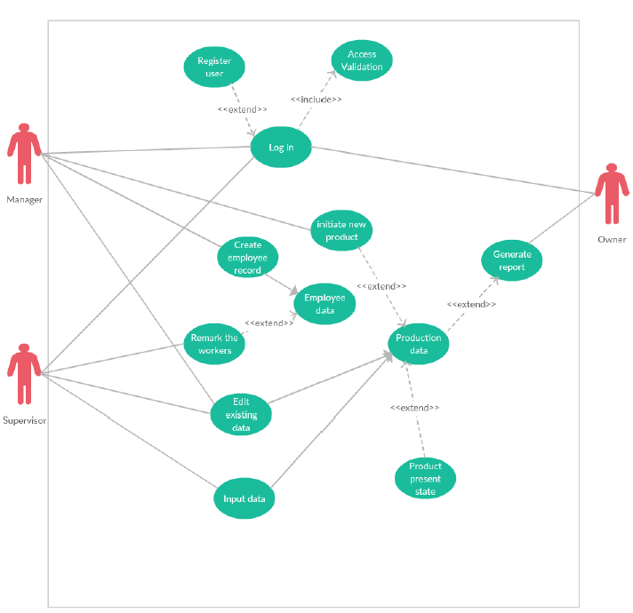
Fig: Use Case

Slide 15
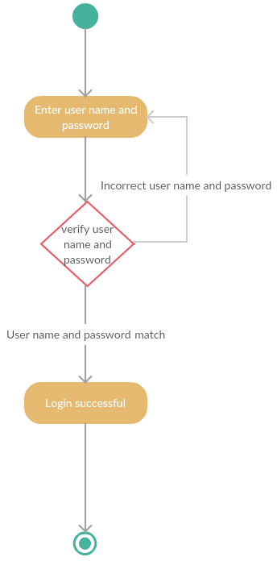
Fig: Activity Diagram (Login)

Slide 16
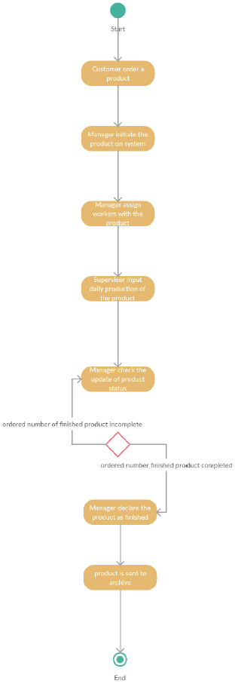
Fig : Activity Diagram production data entry

Slide 17
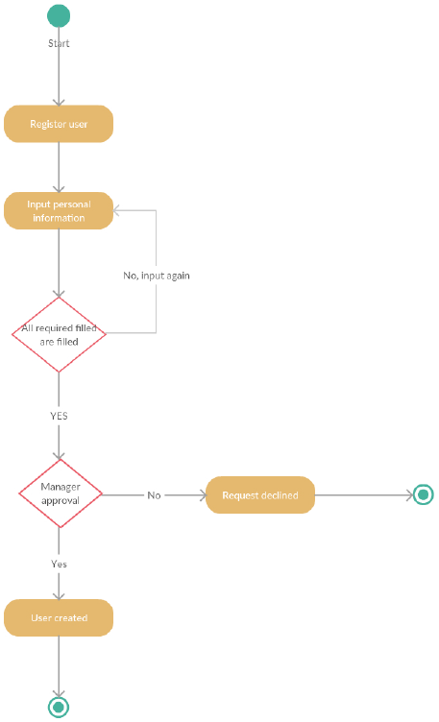
Fig: Activity Diagram (Sing Up)

Slide 18
Development (User Interface )
welcome Page
Log in Page
Registration
Successful Message
Manager Homepage
Owner Homepage
Supervisor Homepage
From manager accounts
Supervisor Info
Edit Team Info
Edit Product Information
Supervisor Log
From owner accounts
Edit Manager Information
Editing Owner Information
Manager Log (Product)
Manager Log (Team)
From supervisor accounts
Edit Worker Information

Slide 19
Software Testing (Test Plan)
Test coverages :
Basic Features Test :
“Create Account” test
Login test
Homepage test (Manager, Owner ,Supervisor )
User data ( inside Supervisor info, Manager info and Owner info ) (Content , Table, Operations)
production data (Content , Table, Operations)
Remark the workers (Content , Table, Operations)
Manager Log (Product ,Team , Clear Log)
Supervisor Log (Product ,Workers, Clear Log)
Team info (Content , Table, Operations)
Additional Test :
Main Homepage
Navigation (options in every page )
Form icons ( for all pages )

Slide 20
Project management
Task | Time(Week)
Field study | 0-1
Study on SDLC | 1-2
Study on previous works | 1-2
Prepare user story | 2-3
Identify user requirements | 3-4
Develop Use case diagram | 4-5
Develop Activity diagram | 4-5
Develop Class diagram | 4-5
Develop E-R diagram | 4-6
Create Database | 6-7
Create user interface | 6-8
Software Development | 6-16
Prepare Test plan | 3-4
Prepare Test Suit | 4-6
Prepare Test Suit | 7-17
Documentation | 17-18
Project Scheduling :
Total Project Time: 18 Weeks
Start Date: 15 February, 2017
Release Date: 11 June, 2017

Slide 21
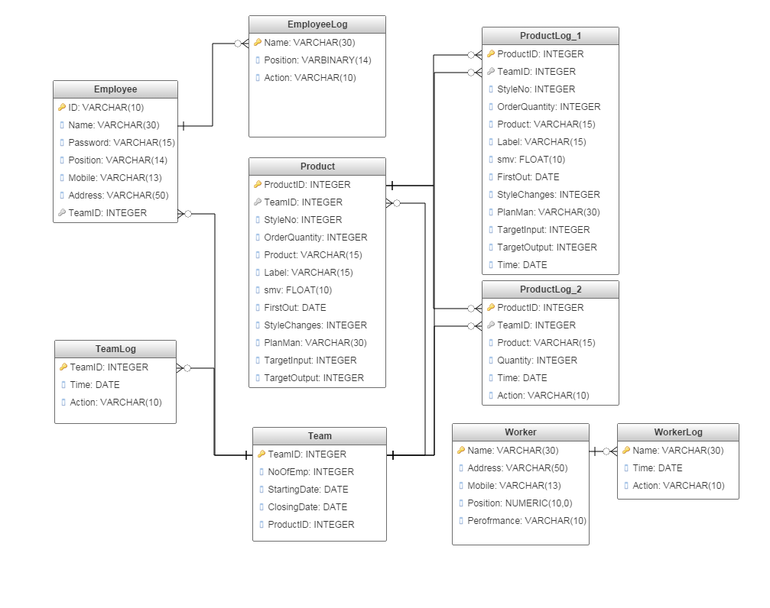
Fig: E-R Diagram

Slide 22
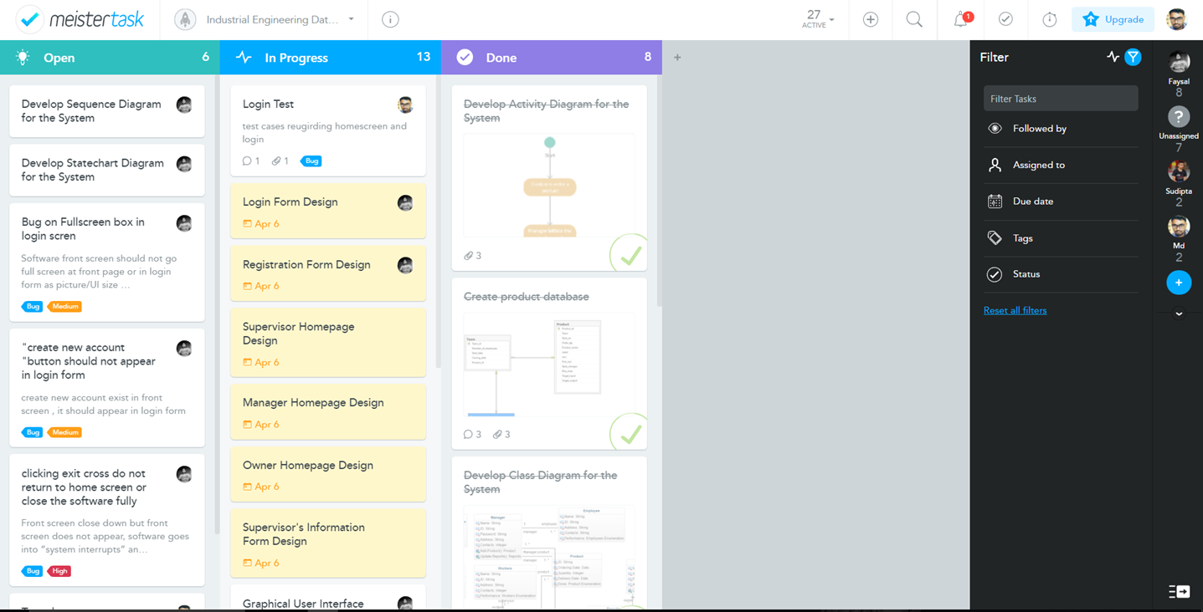
Project Management tool (Meistertask)
MeisterTask was used as our project management and issue tracking tool.
Fig : Meistertask Homepage

Slide 23
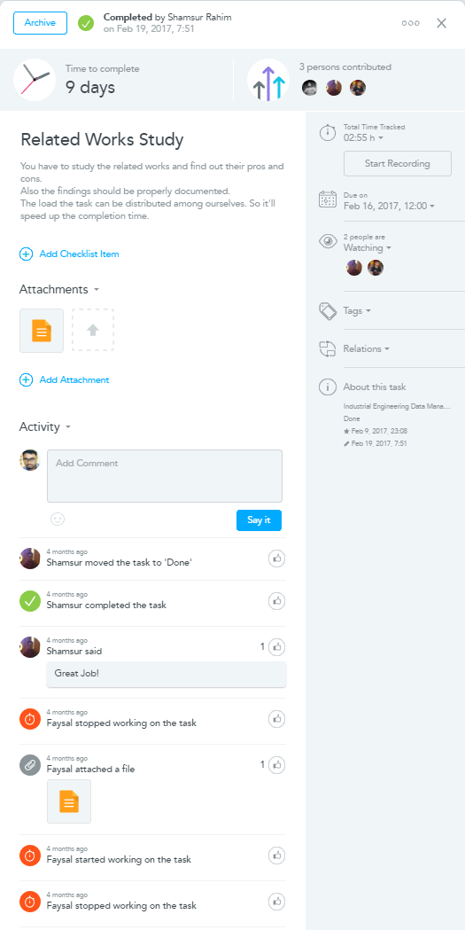
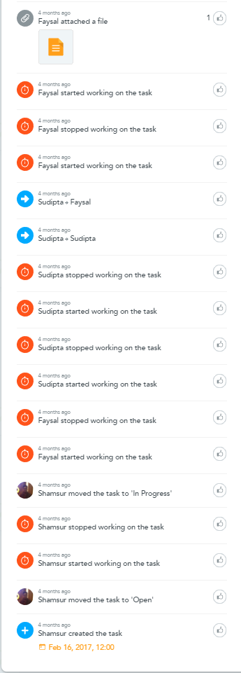
Fig: Sample task Fig :Activities related to task

Slide 24
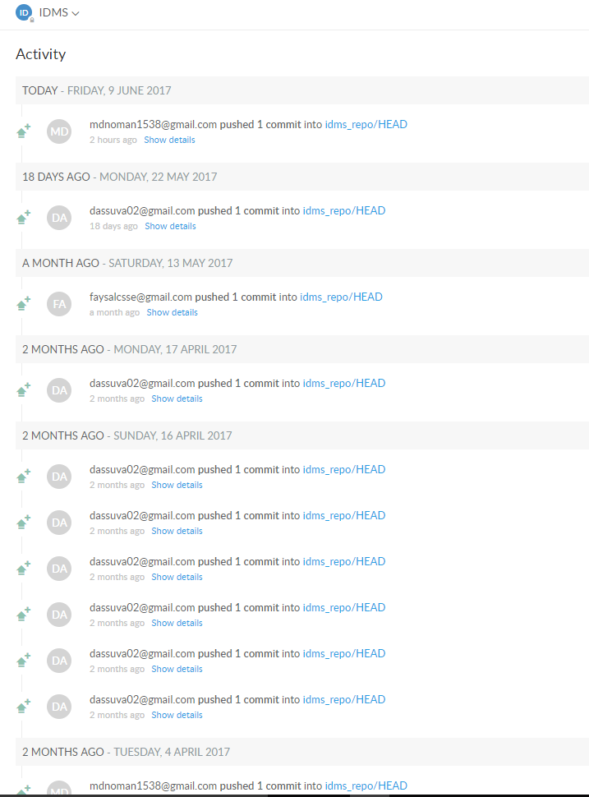
Repositories (deveo)
We used Deveo as our online repository.
By using Tortoise SVN we can access the repository
from everyone’s computer .
Fig : Repository use history

Slide 25
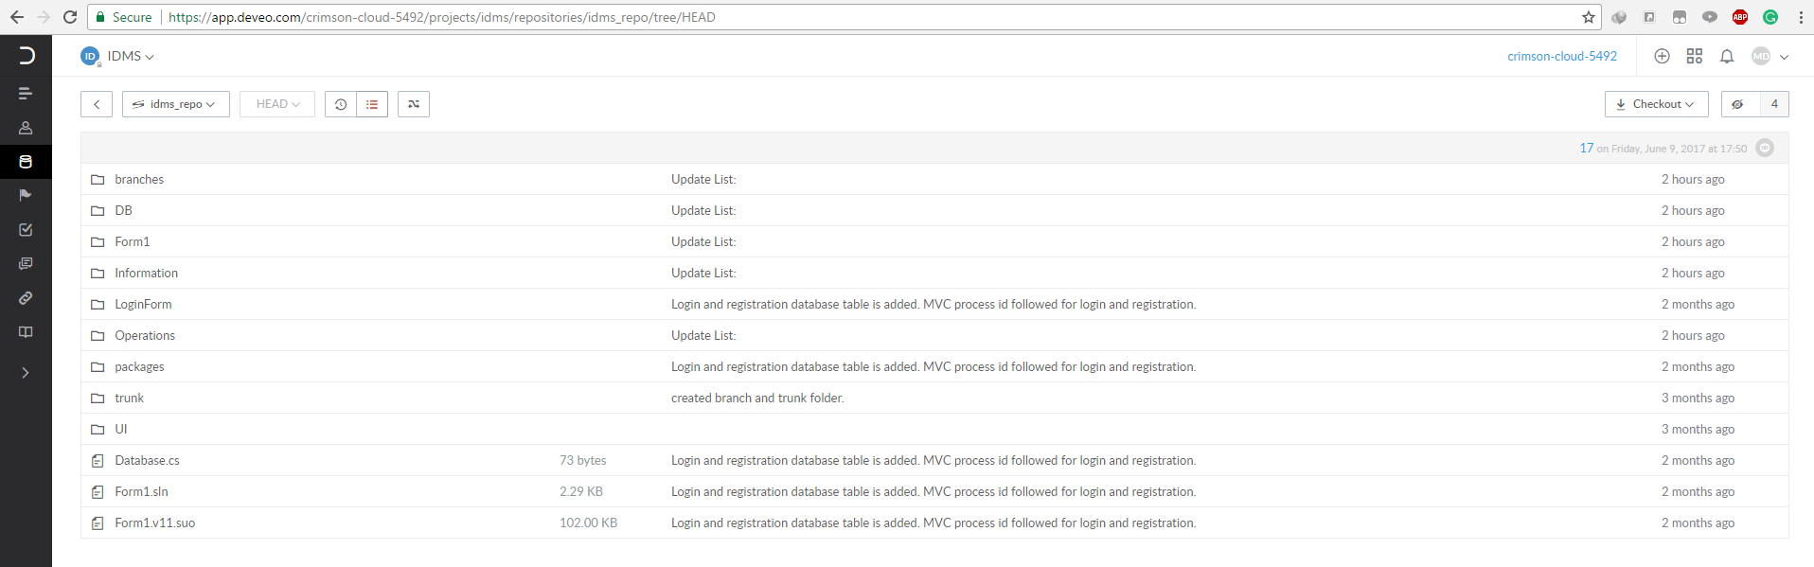
Fig : Repository folders

Slide 26
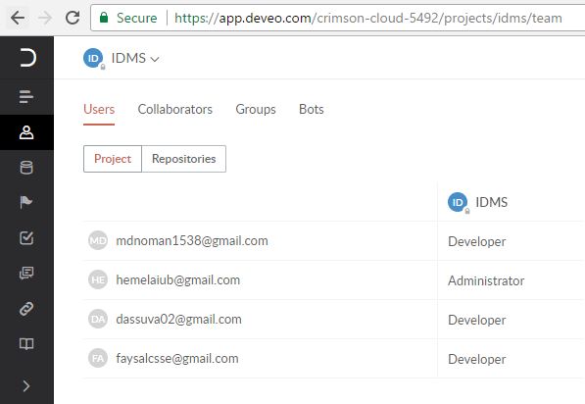
Fig : Repository users

Slide 27
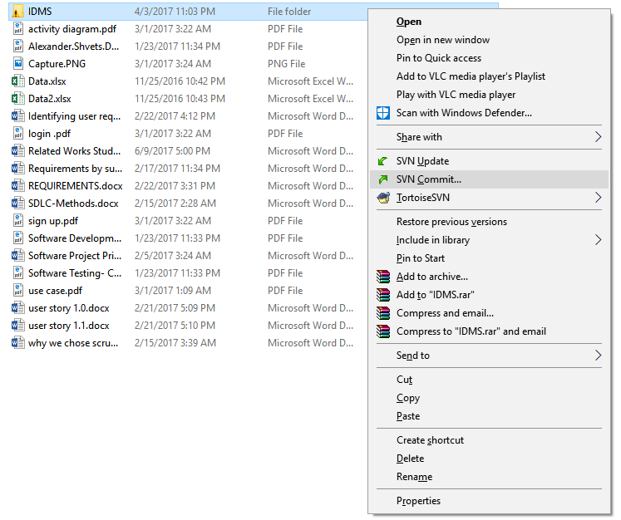
Version controlling tool (tortoise SVN)
We used Tortoise SVN as our
version controlling tool with
the help of Deveo repository
Fig : Update or step 1 to commit

Slide 28
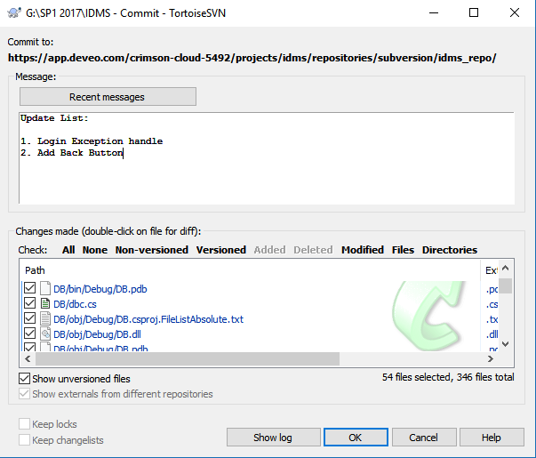

Slide 29
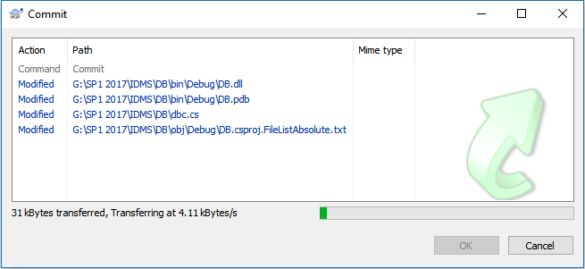
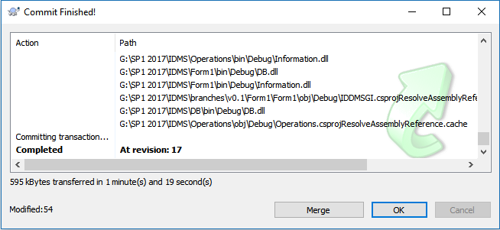
Fig : Committing process

Slide 30
References
1.Shamsur, M., Rahman
M., & Ehtesham, A. (2017).
Mining Industrial Engineered Data of Apparel Industry: A Proposed Methodology. International Journal of Computer Applications, 161(7) 1-7. doi:10.5120/ijca2017913262
2. http://en.wikipedia.org/wiki/Software_documentation
3. http://www.meistertask.com/app/dashboard
4. http://tortoisesvn.net/downloads.html
5. http://app.deveo.com/login

Slide 31


